Slide 1




GOMATI DISTRICT POLYTECHNIC
Office Management System
PRESENTED BY:
Arkajyoti Roy (216305131)
Argha Chakraborty (216305130)
Aradhito Chaudhuri (216305129)
Shreyanka Das (216305124)
Shirsendu Das (216305157)
Priyangshu Dey (216305148)

Slide 2
CONTENT
01
02
03
04
05
06
07
08
09
INTRODUCTION.
KEY FEATURES.
ADMIN PORTAL
MANAGER PORTAL
EMPLOYEE PORTAL
TECHNOLOGIES USED
FUTURE SCOPES
CONCLUSION
REFERENCES

Slide 3

Introduction
Workstream is a specialized Office Management System created to enhance the supervision of employees and visually represent their ongoing progress on specific tasks in an innovative manner. This approach simplifies workflow management for managers, enabling them to make informed decisions. The software aims to simplify project management by dividing extensive projects into smaller sections, more achievable segments and assigning them to different team members.

Slide 4

Task & Project Management.
Chat Section.
Employee’s Performance.
Document Management.
Calendar & Scheduling.
Key Features

Slide 5

Admin Portal
The admin portal is the main control center for administrators to oversee office operations efficiently. It allows defining roles, settings permissions, managing inventory, equipment, maintenance schedules, and storing important documents centrally.

Slide 6
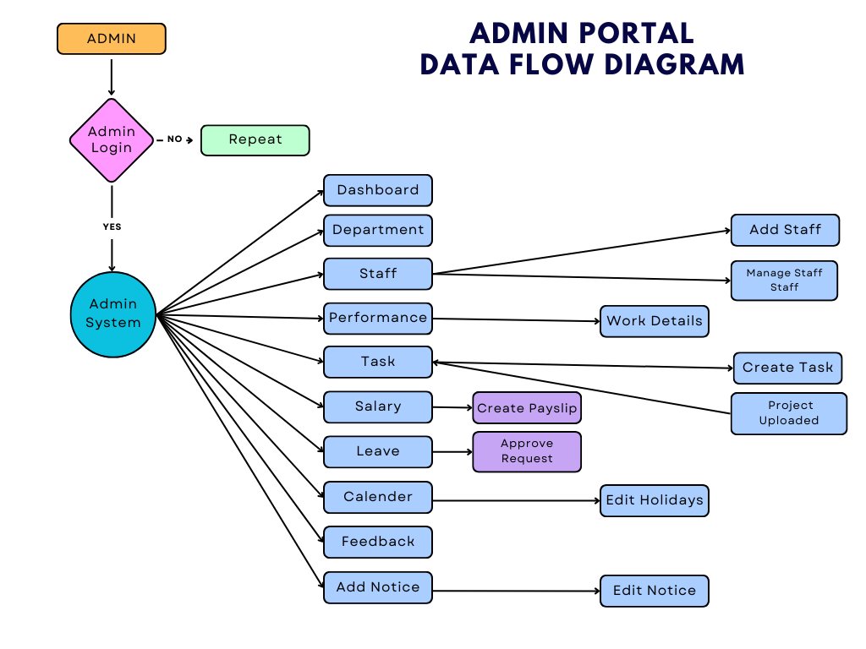

Slide 7
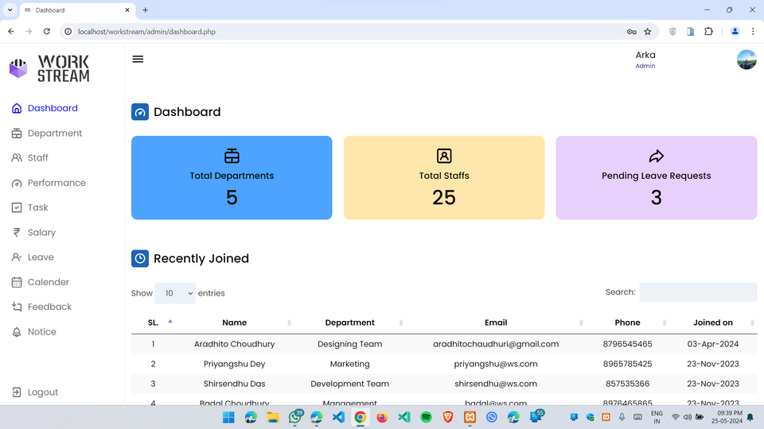
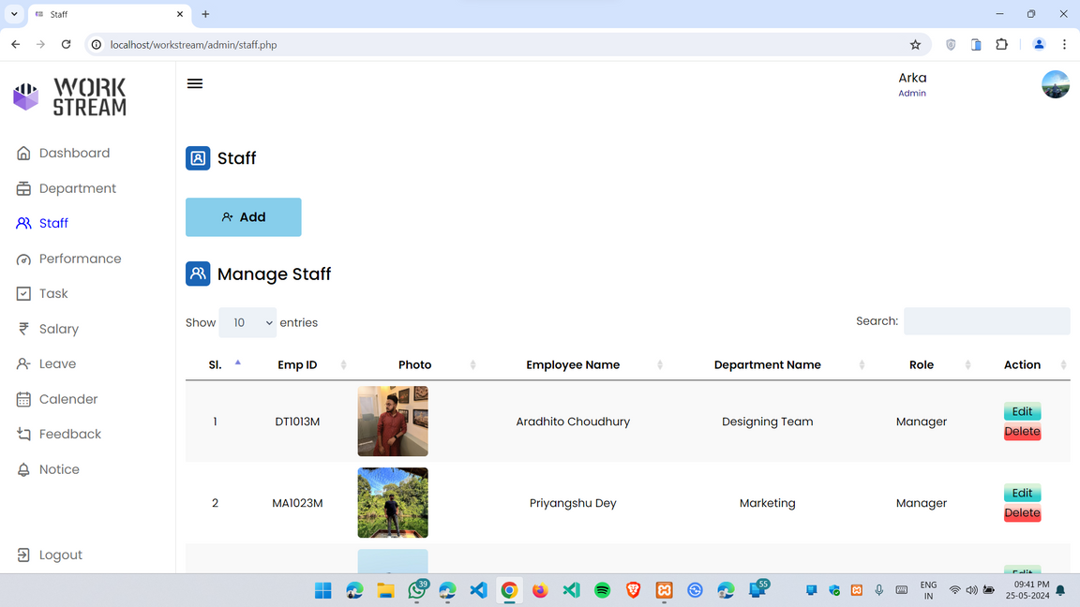
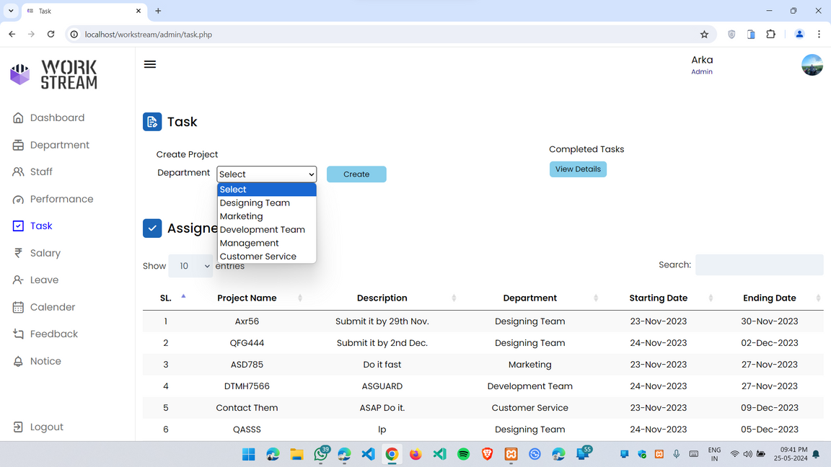
DASHBOARD
The admin can view the overall department, staff, leave requests, and newly hired employees.
STAFF
Admins can add new employees and oversee their accounts by editing or deleting them as needed.
TASK
The administrator has the ability to assign tasks to departments and download completed tasks once they have been uploaded by employees.

Slide 8
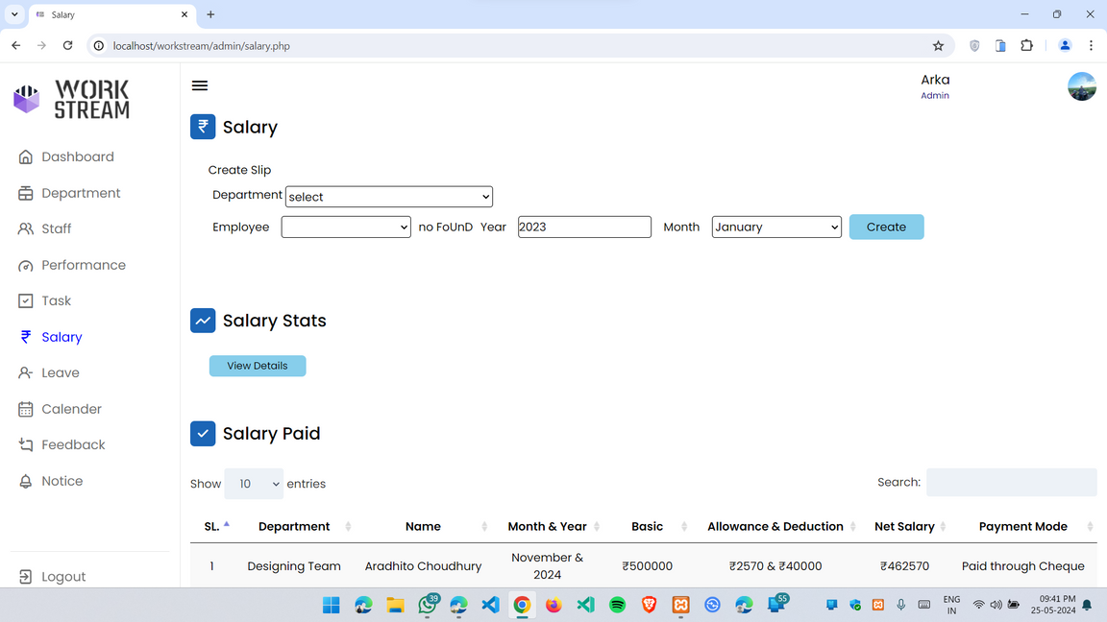
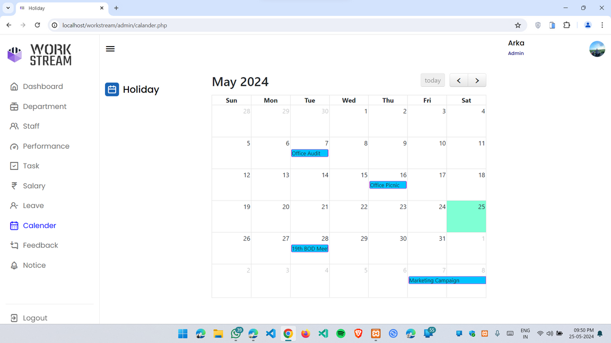
SALARY
Admins have the ability to generate salary payslips for employees and view comprehensive statistics presented graphically.
CALENDER
Admins have the ability to establish custom holidays and schedule upcoming meetings for both departments and employees.

Slide 9

Manager Portal
The manager portal is a centralized digital platform for optimizing departmental and managerial duties. It allows managers to oversee office operations, providing essential tools and data for effective team and resource management.

Slide 10
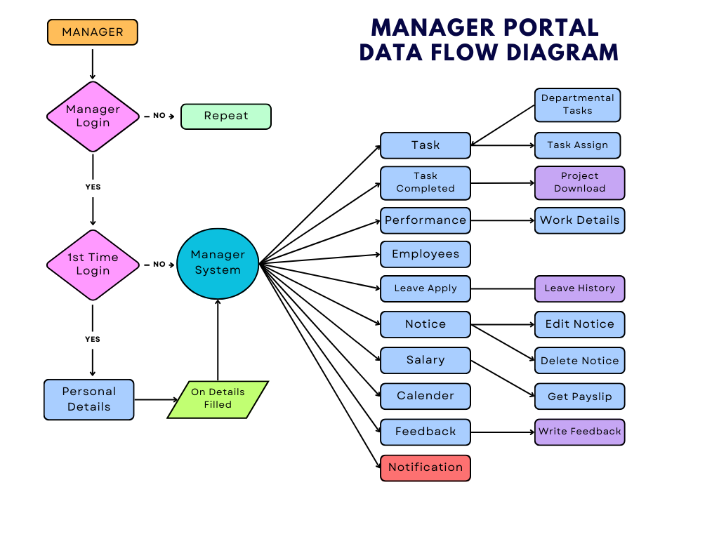

Slide 11
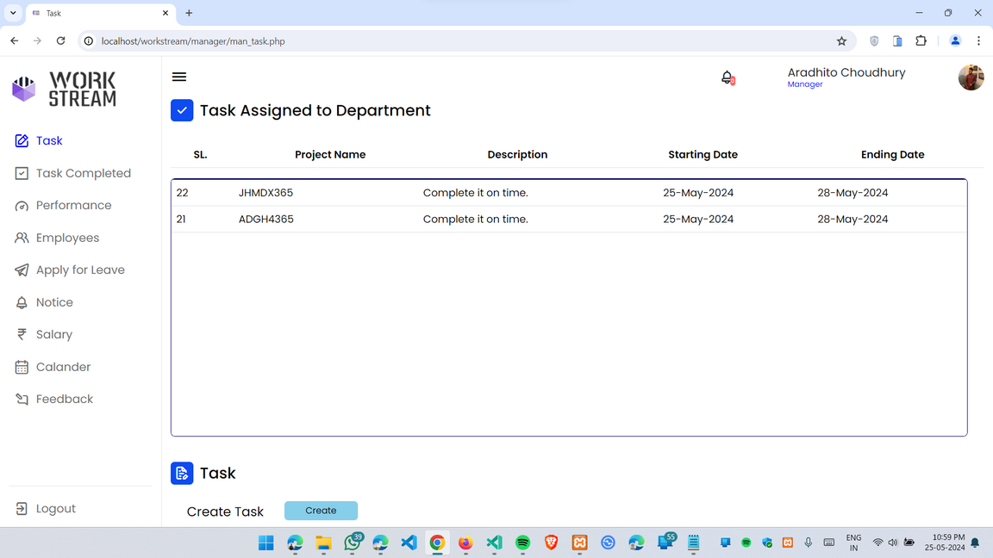
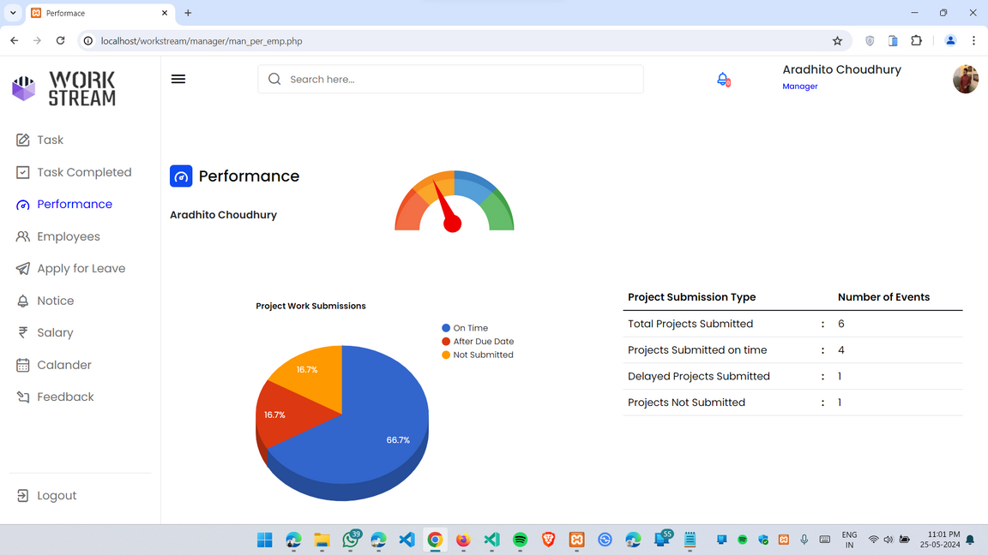
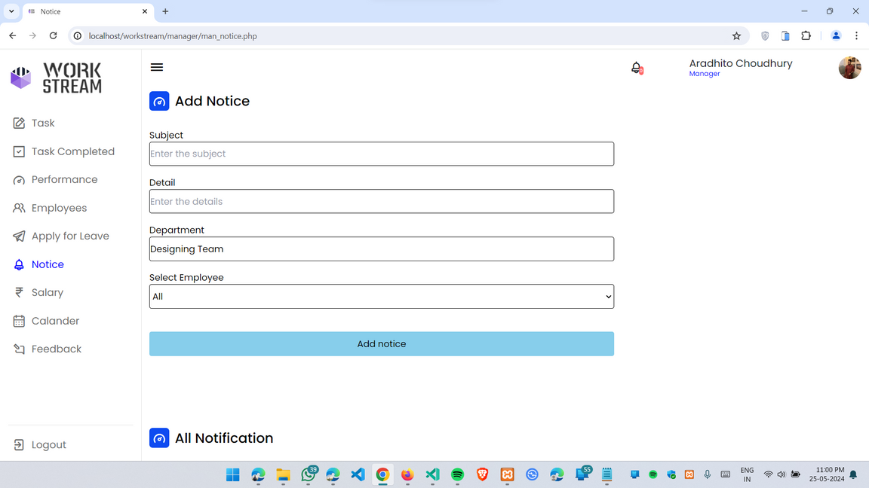
TASK
The manager can view the tasks assigned by the admin to their department and subsequently assign tasks to the employees within that department.
PERFORMANCE
The manager can evaluate each employee's performance based on their work within the department.
NOTICE
The manager has access to the notices shared by the admin and can then distribute them to the whole department or specific employees within the department.

Slide 12
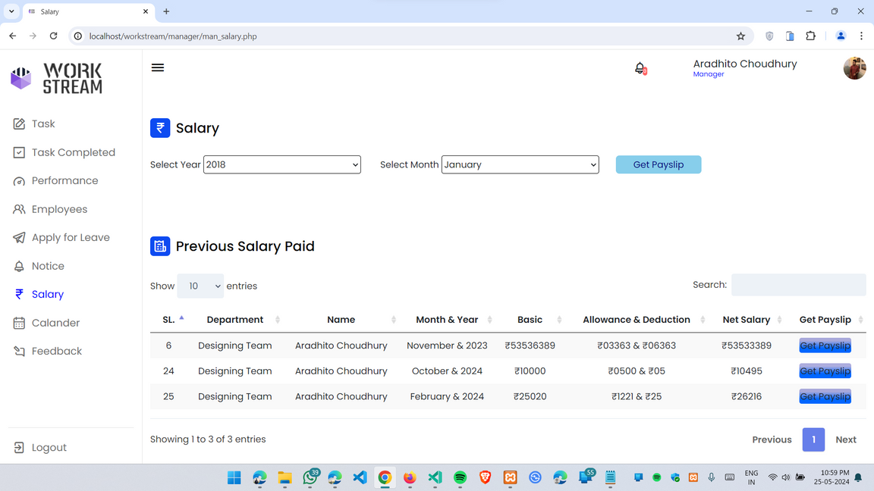
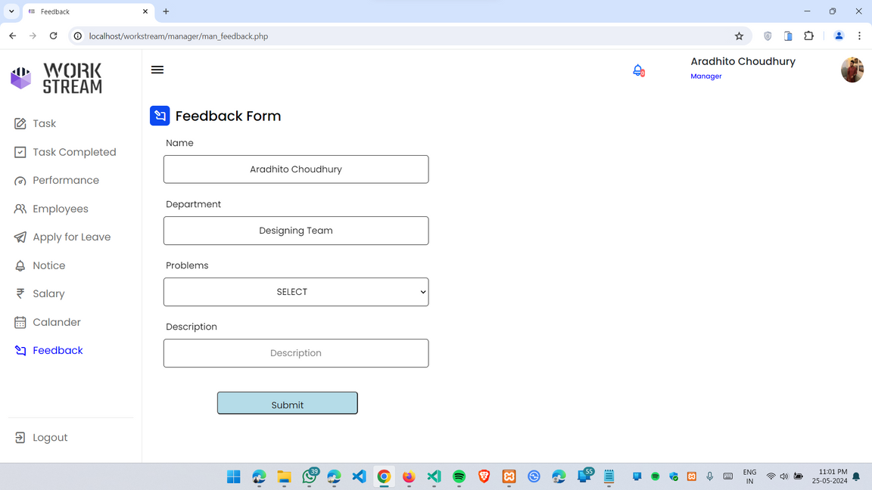
SALARY
The manager can view their current and previous salary payslips in PDF format by selecting the year and month, and they also have the option to download them.
FEEDBACK
The manager can offer feedback to senior administrators regarding the matter to determine the optimal solution.

Slide 13

Employee Portal
The employee portal streamlines operational tasks by offering easy access to company information, project submissions, performance monitoring, and feedback, enhancing productivity of the employees through continuous assessment and improvement.

Slide 14
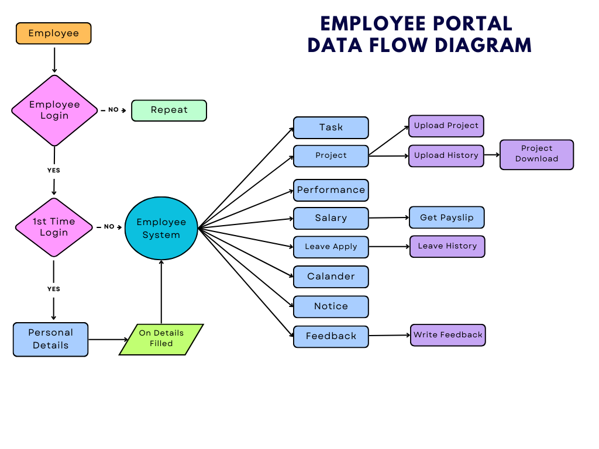

Slide 15
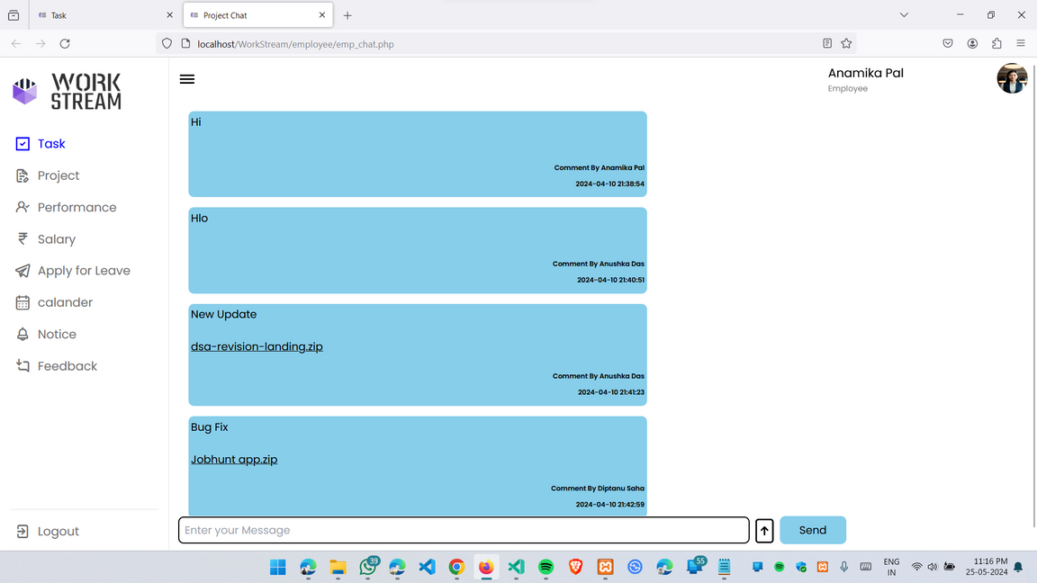
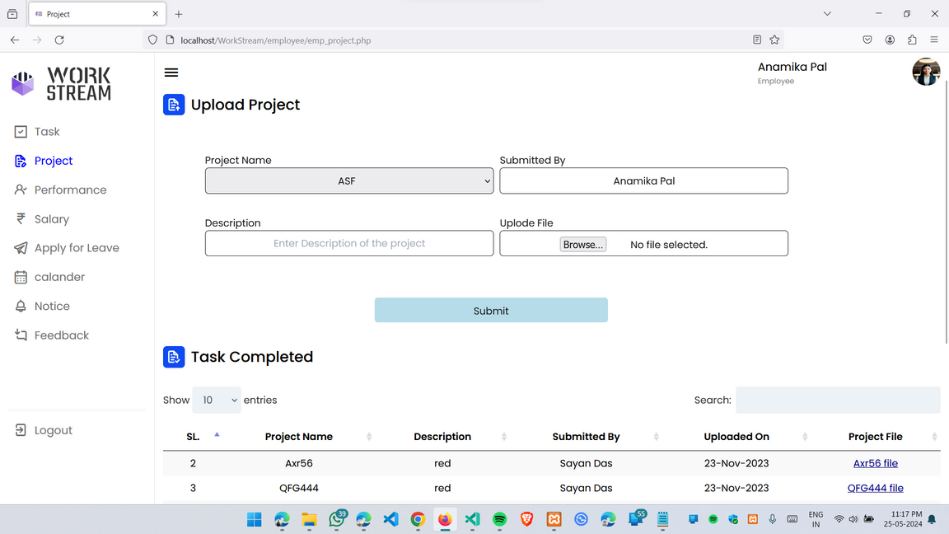
CHAT
Employees can communicate within their project group, share files, and allow the leader to review them.
PROJECT
After completing a project, employees have the option to upload the project file and download it at a later time if necessary.

Slide 16
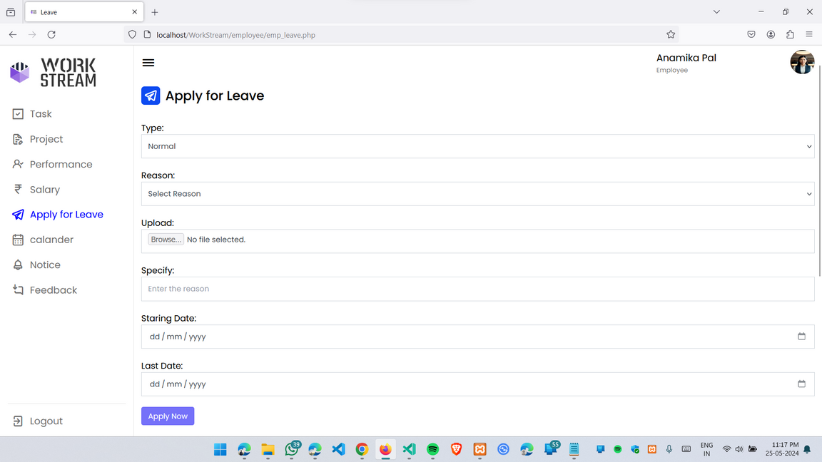
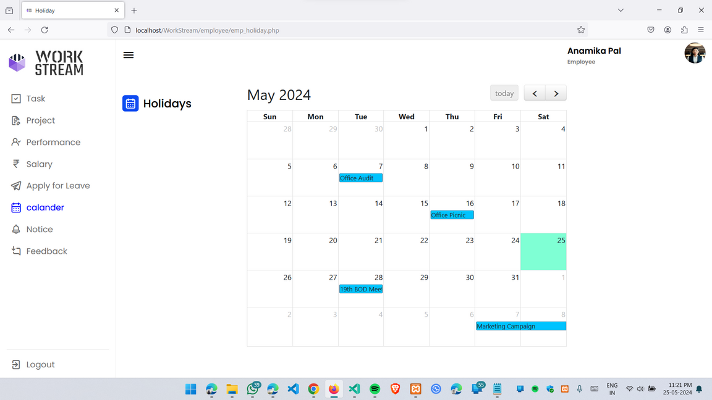
APPLY FOR LEAVE
Employees can request leave from the admin, who can also review their leave records in the leave history section.
EVENT CALENDER
Employees can view holidays, upcoming events, and meetings here.

Slide 17

Technologies Used
Frontend Technologies:
Backend Technologies:
HTML
CSS
JavaScript
AJAX
Tailwind CSS(Framework)
Server-side language (PHP)
Web Server (Apache)
Database (MySQL)

Slide 18






Future Scope
Increasing efficiency and productivity.
Reducing costs and improving cost control.
Enhancing collaboration and teamwork.
Reducing risks and improving compliance.

Slide 19
Conclusion
1
Managing Office Works
Created to streamline the management and organization of office tasks.
2
Platform Seperation
Separate platforms created for distinct roles enable additional features in different system sections while being linked to the same database for data exchange and operations.
3
Secure
It is secure because secured versions of operating systems, database management tools, and firewalls were used.

Slide 20

Reference
ZOHO PAYROLL
https://www.zoho.com/in/payroll/online-payroll-management/
PLANMYLEAVE
https://www.planmyleave.com/Index
FPDF
http://www.fpdf.org/
CLICKUP
https://clickup.com/blog/office-management-software/
DEEL
https://www.deel.com/paid-lp/performance-management

Slide 21

Thank you!
TEAM WORKSTREAM

